Slide 1

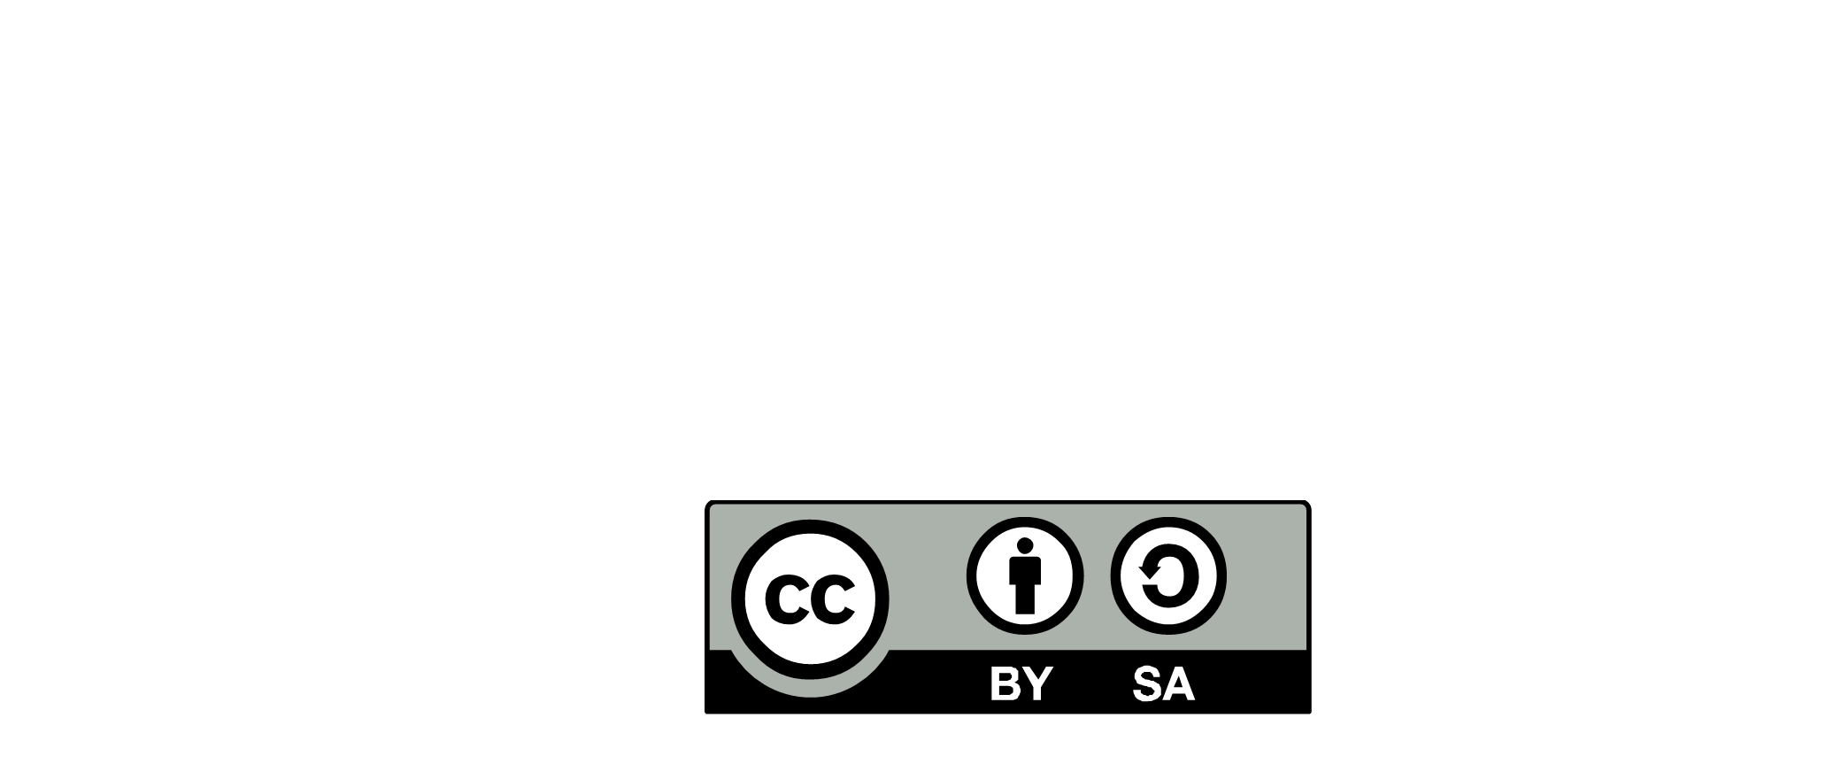


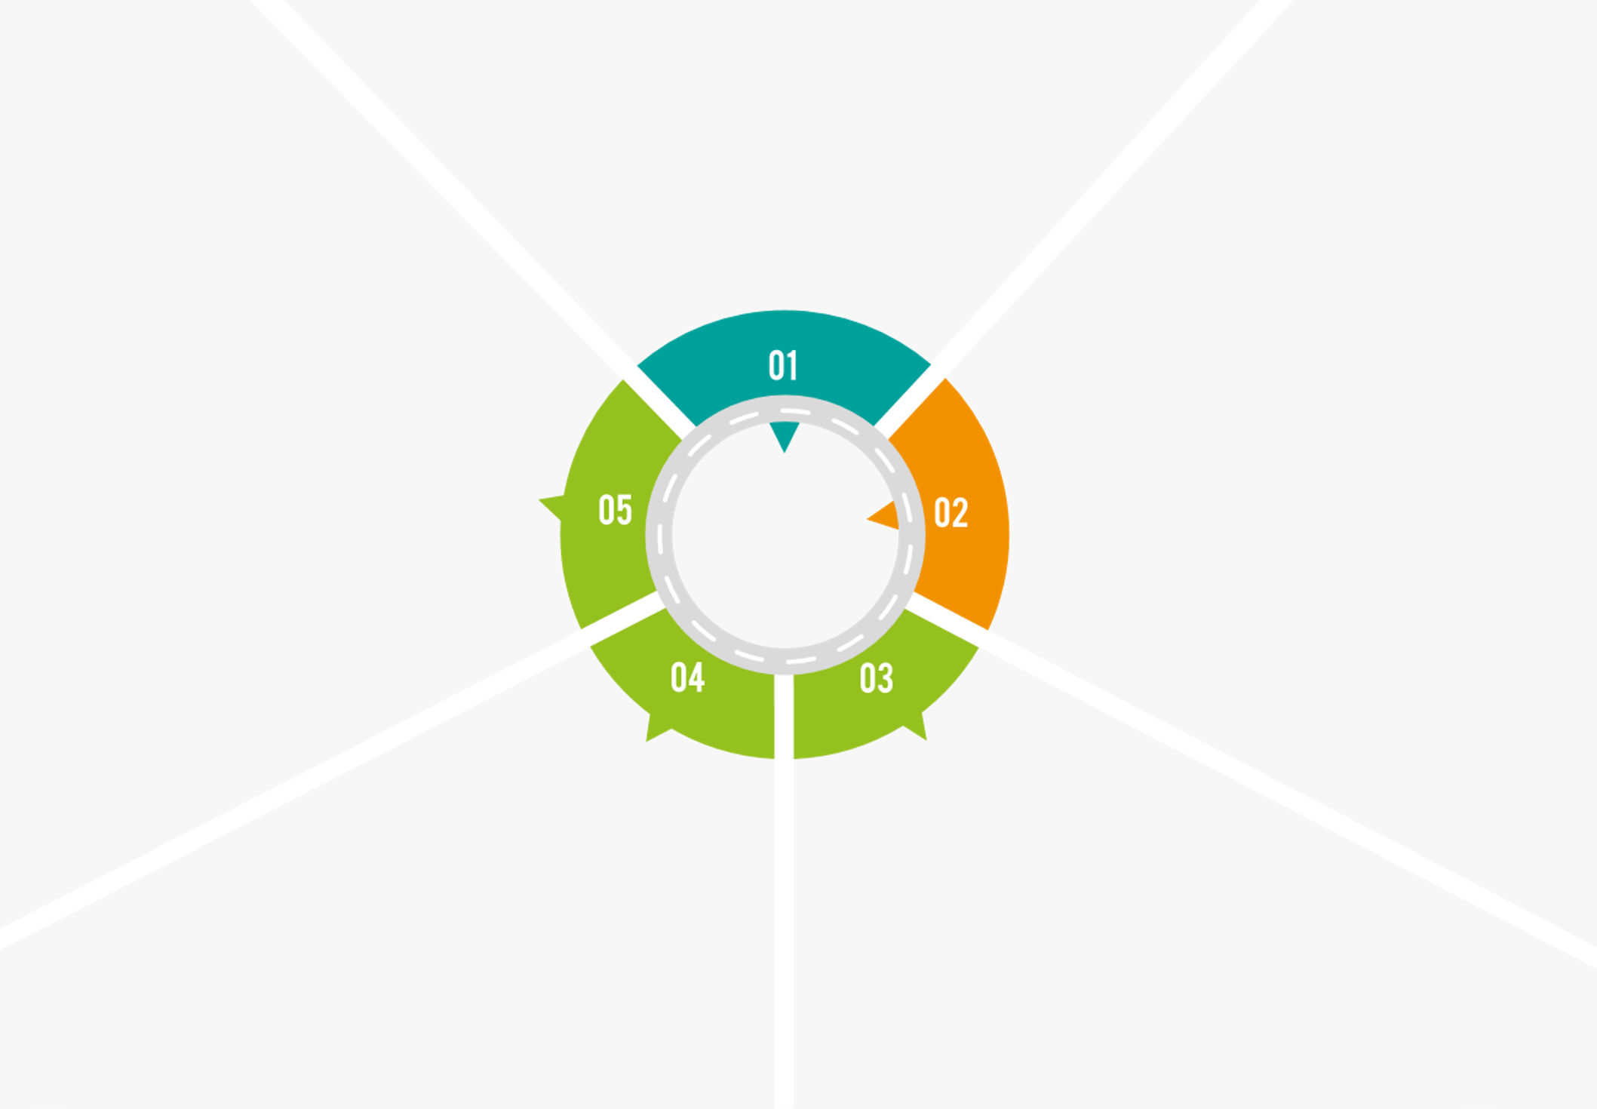

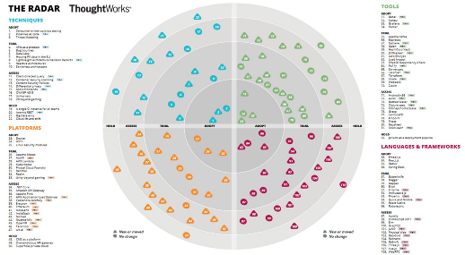
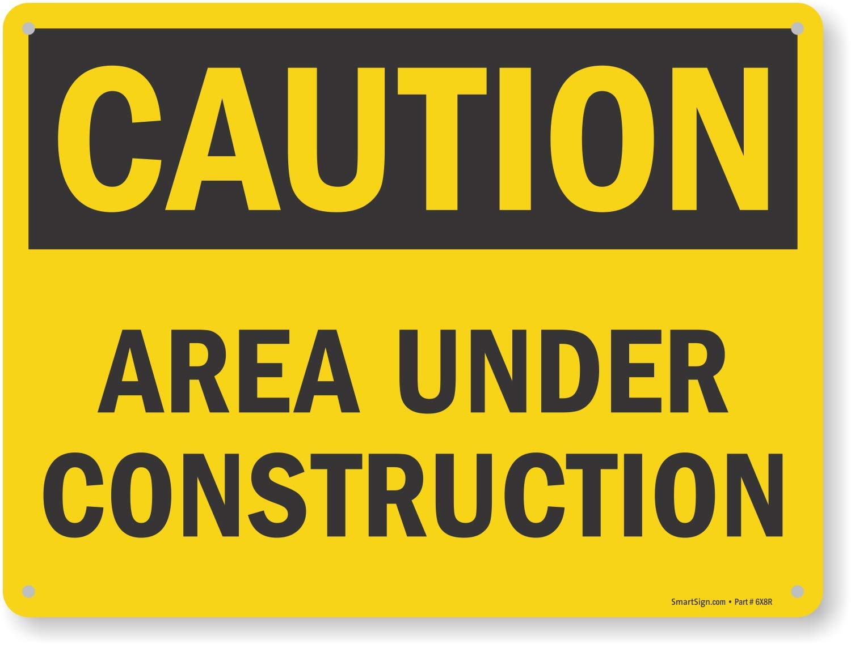
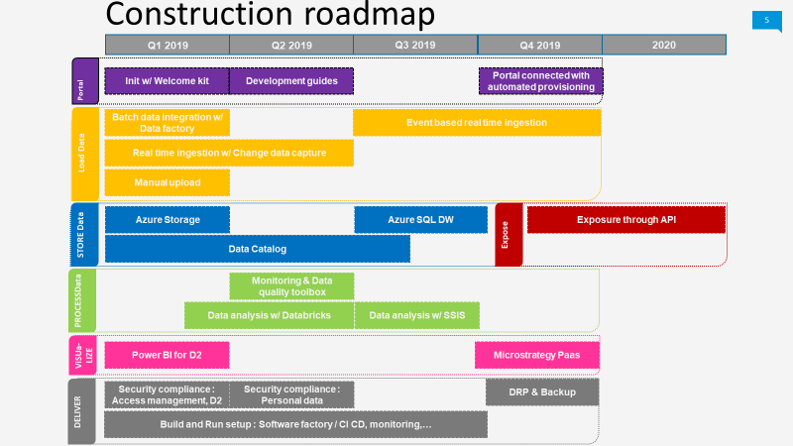
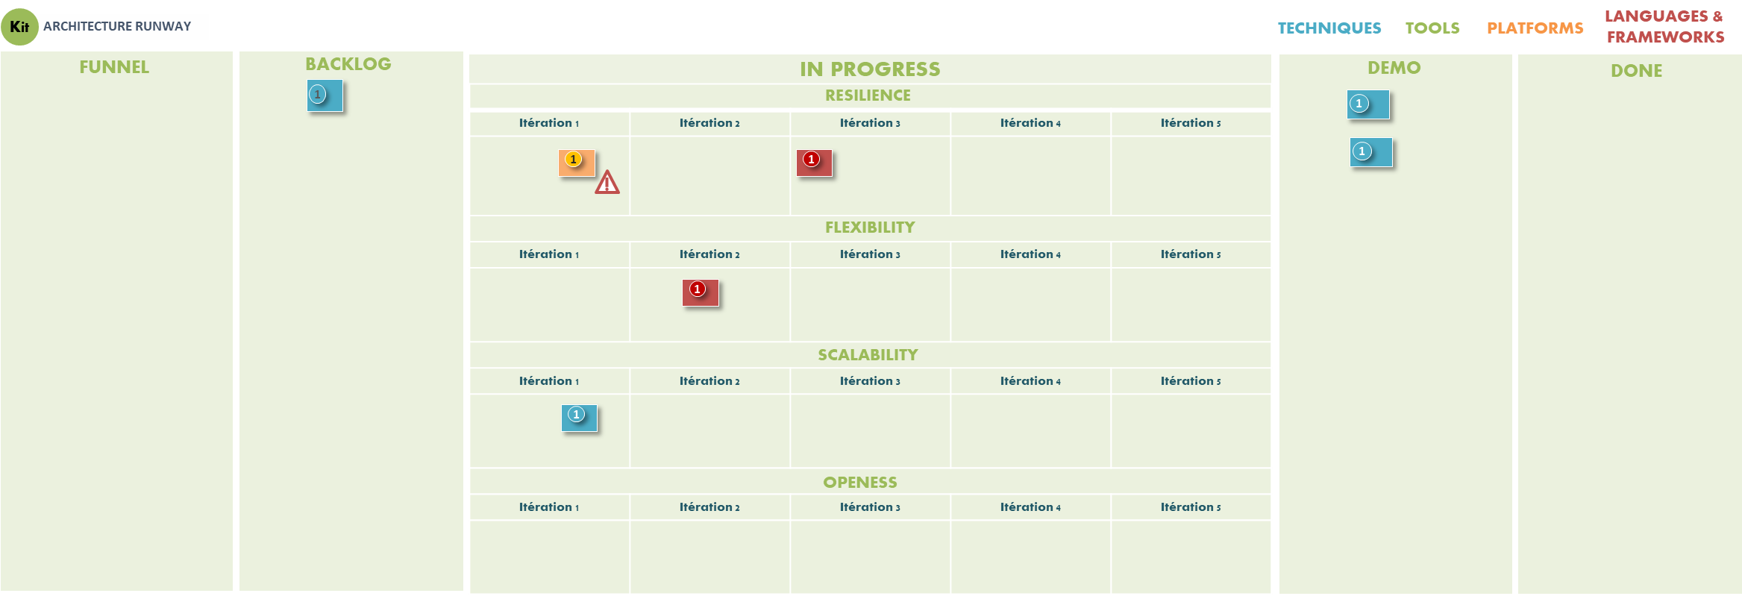


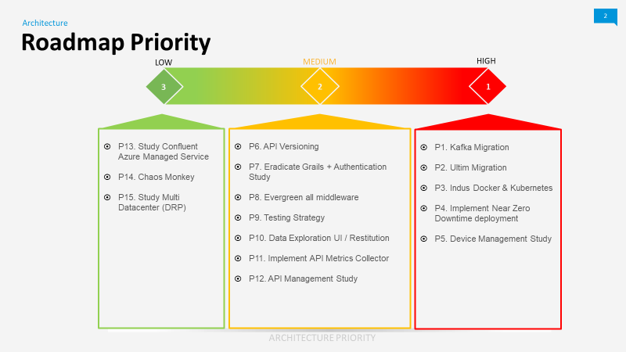
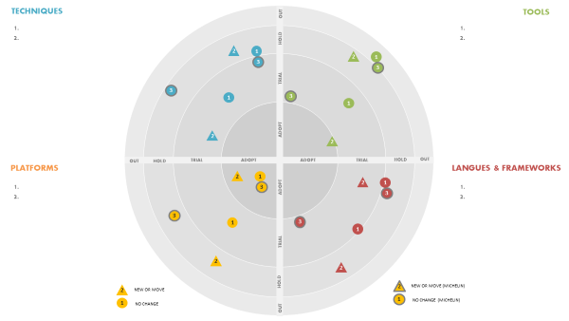

ARCHITECTURE RUNWAY
UPDATE AT EACH MVP
SCOPING 360
01 - INTENTIONAL INPUT
REFERENCE ARCHITECTURE
DOMAIN IS ROADMAP
IT COMPONENT CATALOGUE
BUSINESS AMBITIONS
GLOBAL TECH RADAR
Continually refine fixed/variable constraints and hypothesis !
Build a consolidated roadmap for next MVP and sprint
Consider the product backlog, operability and Non-Functional Requirements
FEATURES
05 – CONSOLIDATED PRODUCT ROADMAP
TIM (example)
CONSOLIDATED PRODUCT ROADMAP
02 – EMERGENT INPUT
FULL STACK
PRODUCT BACKLOG
Build a consolidated backlog
TEAM
SCOPING 360°
Kit
FITNESS FUNCTION
Think to provide an objective integrity assessment of architectural characteristics
FEATURES
ENABLERS
CONSOLIDATED PRODUCT BACKLOG
Adopt the team communication language and be part of the rituals !
Think with multi horizons :
~3 months to ~3 years !
Define the priorities
Select the tech to consider, asses, hold, phase out.
ARCHITECTURE
DECISION
ENABLERS
Kit
ADR
TIM (example)
DECISION LOG
ARCHITECTURE BACKLOG
PRODUCT TECH RADAR
04 – ARCHITECTURE BACKLOG
03 – ARCHITECTURE ASSESMENT

